Slide 1


PUNE SHUTTLE LINE
Best Bus Ticketing Software using C++

Slide 2


B.R.A.C.T’s
Vishwakarma institute of information technology,Pune
Class:FY
Division:M
Batch:M1
Name | Roll Number | PRN NO
Vaibhav Pawar | 1313 | 22110205
Navnath Chavan | 1314 | 22110237
Himanshu Shedam | 1315 | 22110266
Aditya Shelar | 1316 | 22110285
Atharv Tembhurnikar | 1317 | 22110317
Amit Jambhale | 1318 | 22110333

Slide 3
Introduction
The main motive of our project is to provide a Bus Reservation System software that handles the entire booking data of the Bus. It is fully based on the concept of reserving bus seats for various destinations. Previously the task of handling the tickets at a time was very difficult, so there was a need for software that can handle all Bus Reservation systems

Slide 4
Abstract
This Online Bus Ticket Booking project will provide an Online bus ticket booking platform and thereby leverage the tedious manual ticket booking activity for a customer. We can come up with features like saving favorite routes and providing discounts for the same. We can provide a feature that will allow the customer to get a ticket booked without much hassle.

Slide 5
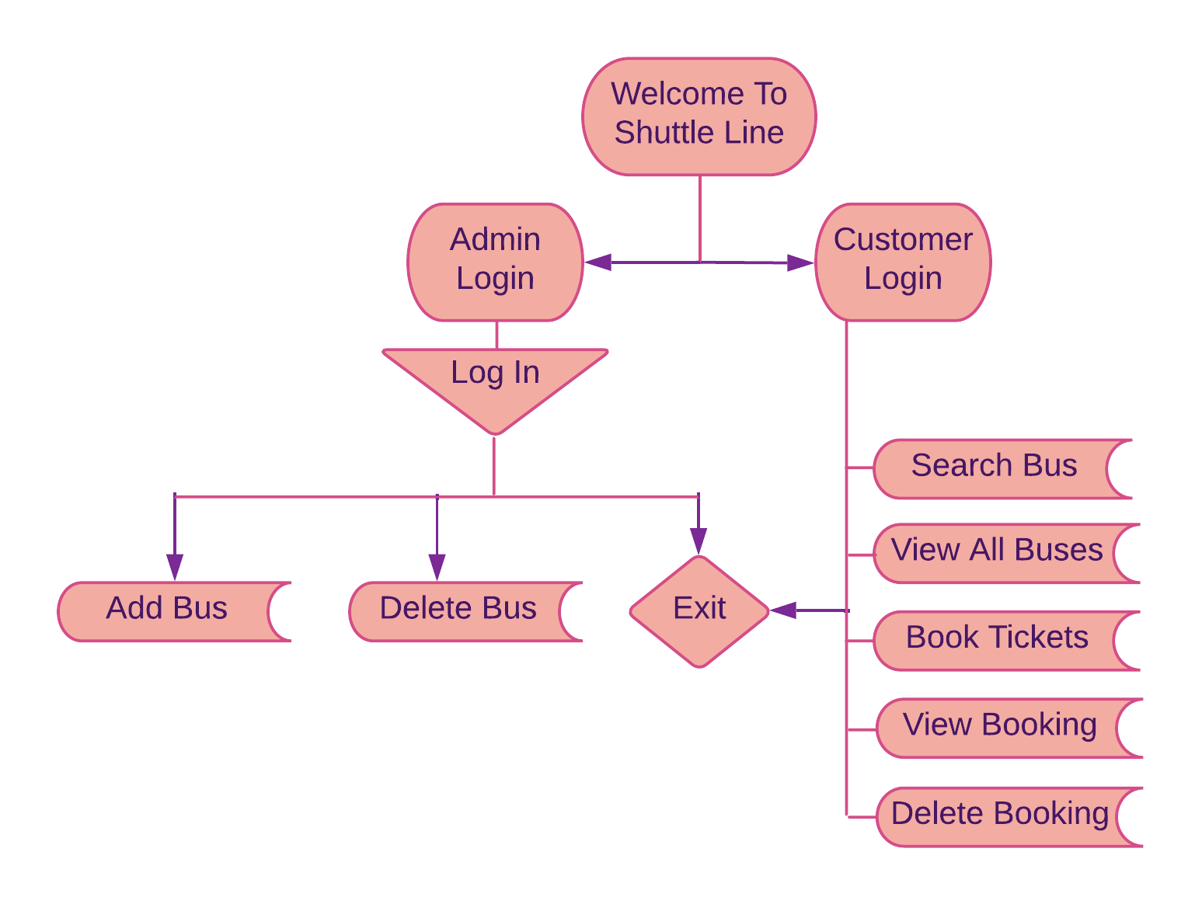
Flow Of Programme

Slide 6
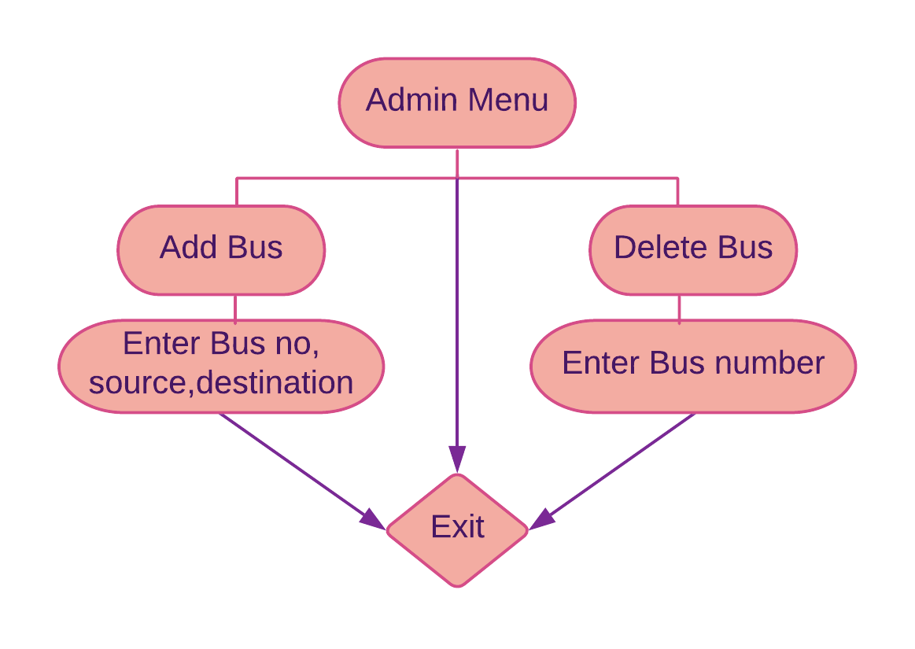
Flow Of Programme

Slide 7
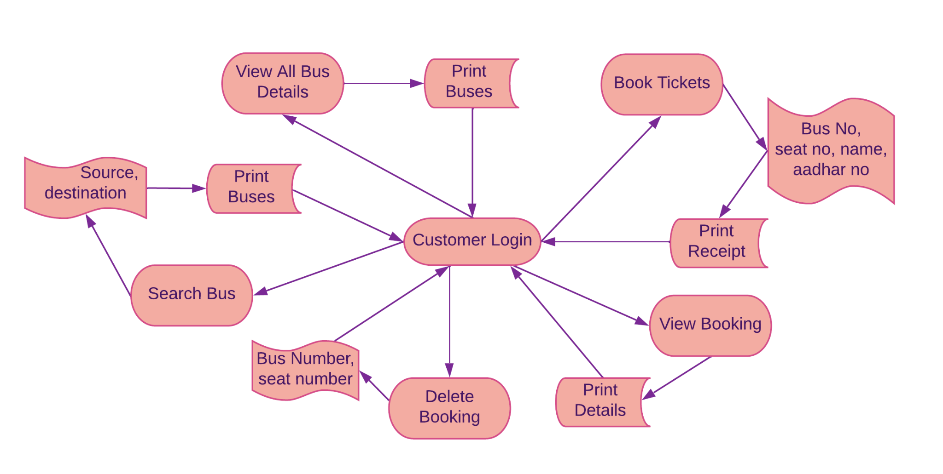
Flow Of Programme

Slide 8
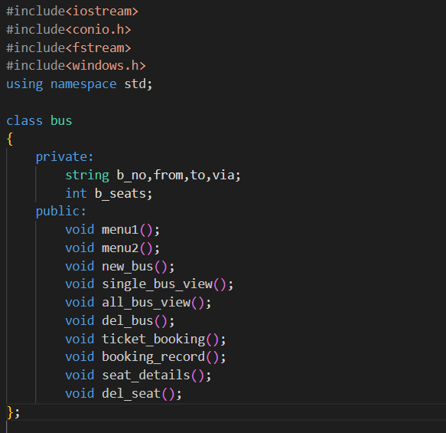
Code

Slide 9
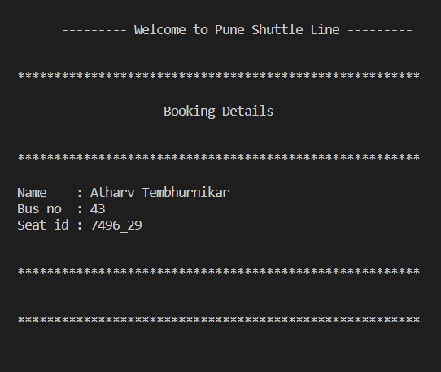
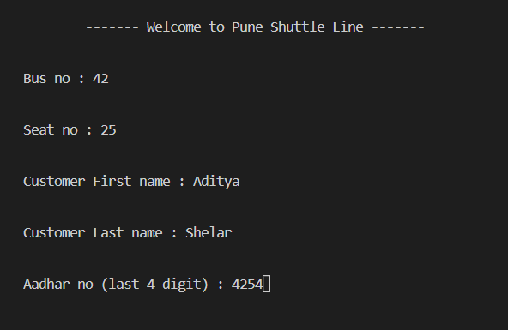
Output

Slide 10
Concepts Covered From Syllabus
Loops
If-else if-else
for
While
Do-while
switch-case
User defined functions
classes & objects (Object oriented programming)
Break, goto statement
Basic functionality for input and output i.e. cin and cout

Slide 11
Concepts which are out of Syllabus
File Handling (fstream)
Windows.h, conio header file

Slide 12
Future Modifications
Software can be modified with the help of web dev. /app development.
We can provide SMS based alerts and email notifications for bookings.
A wallet can be developed to handle payments.
Chat feature can be included in the application to chat with customer care.
We can come with a feature that will allow the customer to save favourite routes.

Slide 13
Conclusion
Here all the information about customer that made reservation can be made available just by clicking a button with this new system, some of the difficulties encountered with the manual system are overcome.
It will also reduce the workload of the staff, reduce the time used for making reservation at the bus terminal and also increase efficiency.
The project, as a whole, will give a new way in bus reservations and ticketing processes. The automation and management of seats and reservations will done online.
In this way, we’ve created and executed the Bus Reservation System Project.

Slide 14
Reference
https://www.w3schools.com/cpp/cpp_files.asp
https://learnprogramo.com/bus-reservation-system-project-in-c-download-with-source-code/
https://www.youtube.com/watch?v=7F8XLC3bq68
https://youtu.be/LS1zjr1wog4
https://youtu.be/U_w-RfMrX18
https://youtu.be/UH-7s2o-NaA
https://stackoverflow.com/questions/41652182/how-to-display-asterisk-for-input-password-in-c-using-clion

Slide 15
Thank You!

